Slide 1
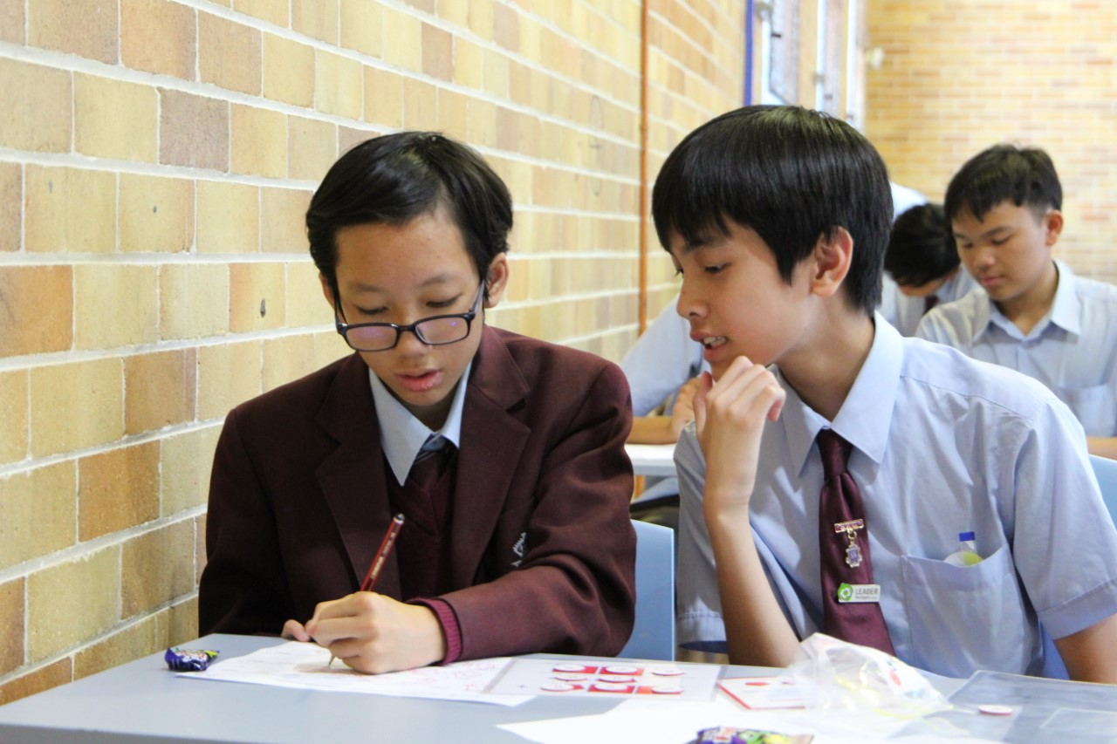
CURRICULUM @ STHS

Slide 3
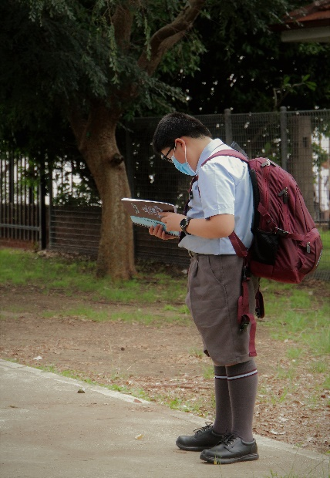
Our School Day!
All students have 36 timetabled lessons per fortnight.
Each lesson is approximately 73 minutes except for Wednesdays, which are shorter to allow for sport.
Assemblies are timetabled each Friday

Slide 4
HOW IS THE SCHOOL DAY ORGANISED?
Start time every day is 8:45am.
Every day begins with READ/roll call.
Finish time for Monday, Tuesday and Thursday is 3:05pm.
Finish time for Wednesday and Friday is 2:25pm.

Slide 5
Sydney Technical High School Bell Times
 | Monday, Tuesday, Thursday | Wednesday Sport | Wednesday No Sport | Friday
READ | 8:45-9:05 | 8:45-8:50 | 8:45-8:50 | 8:45-9:05
Period 1 | 9:05-10:18 | 8:50-9:50 | 8:50-10:10 | 9:05-10:18
Break | 10:18-10:22 | 9:50-9:55 | 10:10-10:15 | 10:18-10:22
Period 2 | 10:22-11.35 | 9:55-10:55 | 10:15-11:35 | 10:22-10:55*
Recess | 11:35-11:55 | 10:55-11:15 | 11:35-11:55 | 10:55-11:15
Period 3 | 11:55-1:10 | 11:15-12:15 | 11:55-1:10 | 11:15-12:30
Lunch 1 | 1:10-1:30 | 12:15-12:35 | 1:10-1:30 | 12:30-12:50
Lunch 2 | 1:30-1:50 | 12:35-12:50 | 1:30-1:50 | 12:50-1:10
Period 4 | 1:50-3:05 | 12:50-2:25 Sport | 1:50-2:25 In roll call rooms | 1:10-2:25
A warning bell will sound three minutes before READ, periods 3 and 4. Bell times may vary on Fridays depending on the duration of assemblies and presentations. *Friday period 2 is assembly, wellbeing activities or year meetings. roll call is taken during the READ Period.

Slide 6
Class Organisation
Year 7 students are grouped into classes according to their geographical location.
Students are split into smaller classes for Visual Arts and Technology .
Roll call classes are also their house groups.

Slide 7
NSW Education Standards Authority - NESA Requirements for Stage 4
Stage 4 – Years 7 and 8
Subject | Year 7 | Year 8
English | 6 | 6
Mathematics | 5 | 5
Science | 5 | 5
History | 0 | 4
Geography | 4 | 0
PDHPE | 4 | 4
Languages | 3 | 3
Visual Arts | 3 | 2
Music | 2 | 3
Technology | 4 | 4
Periods per cycle

Slide 8
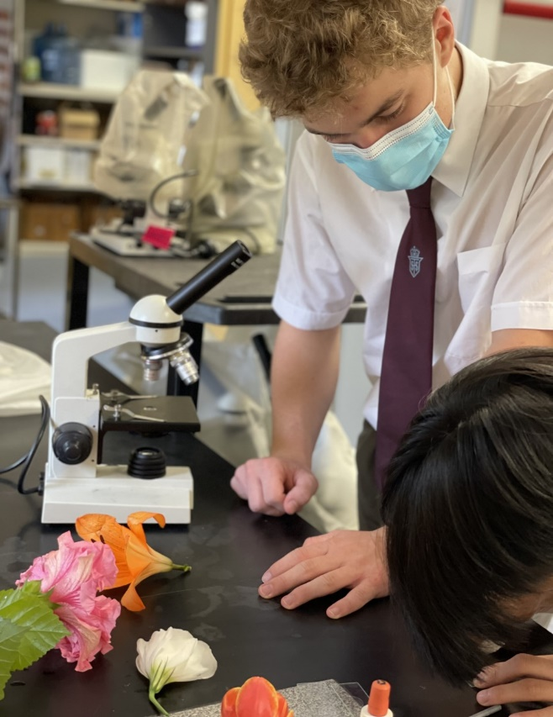
Streaming/Grading
Not introduced in Year 7 or 8.
Years 9 and 10 in English, Mathematics and Science.
Years 11 and 12 in English
and Mathematics

Slide 9
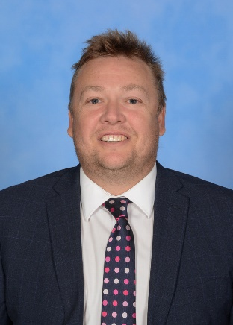
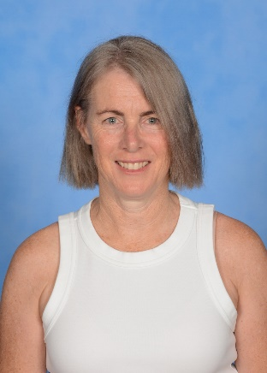
Acceleration
Students with an exceptional ability in a particular subject may be identified to follow an acceleration program in that subject.
Various factors are taken into consideration including: talent, maturity, timetable constraints, behaviour and Head Teacher recommendation.
Applications are made through
the Deputy Principals.

Slide 10
Beyond the Curriculum
The school has a large program of activities for students.
These are advertised on the schools intranet, on the daily bulletin, on the weekly ‘What’s On’ poster and in Tech Talk.
All students are encouraged to immerse themselves in activities that interest them.
INTERACT
STUDENT REPRESENTATIVE COUNCIL
MEDIA
WYKEHAM AWARD
ENVIRONMENT TEAM
Music
CHESS
sport
DUKE of EDINBURGH
DEBATING

Slide 11
Beyond the Curriculum
Leadership and Peer Support
Music – Instrument Tuition, Bands, Choir
Environment Team – Enhancing our School
Interact – Volunteering and Charity work
Sound and Light Team and the Digital Media Team

Slide 12
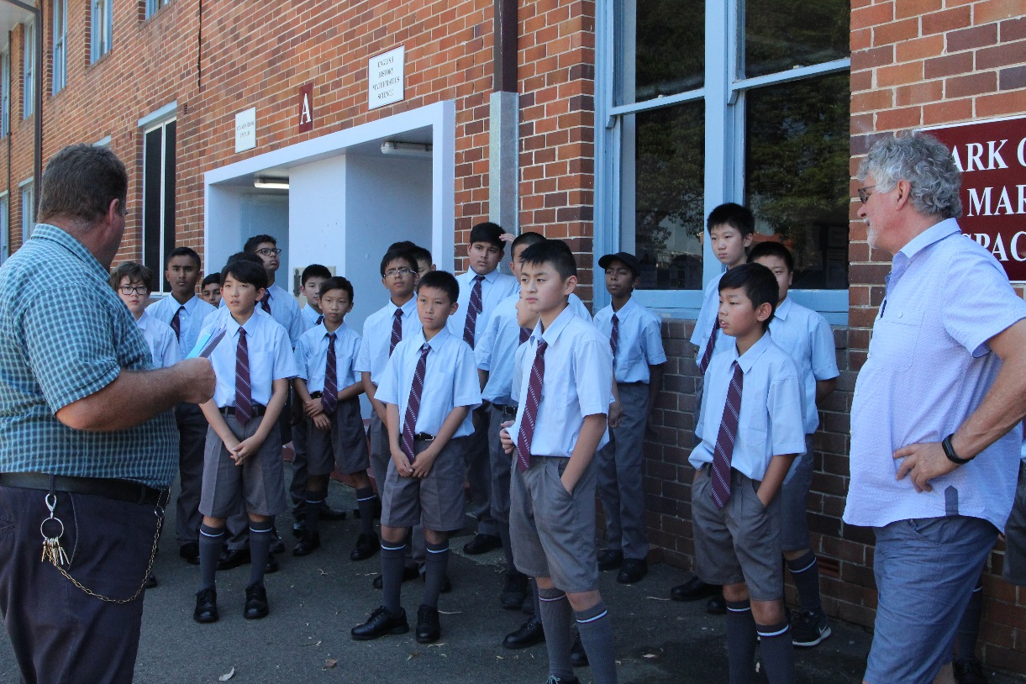
Beyond the Curriculum
Public Speaking and Debating
Sport Knockout teams
Chess
Duke of Edinburgh

Slide 13
Beyond the Curriculum
Weekly Maths Quiz
Tech Tutoring
Student Representative Council
Library Assistants

Slide 14
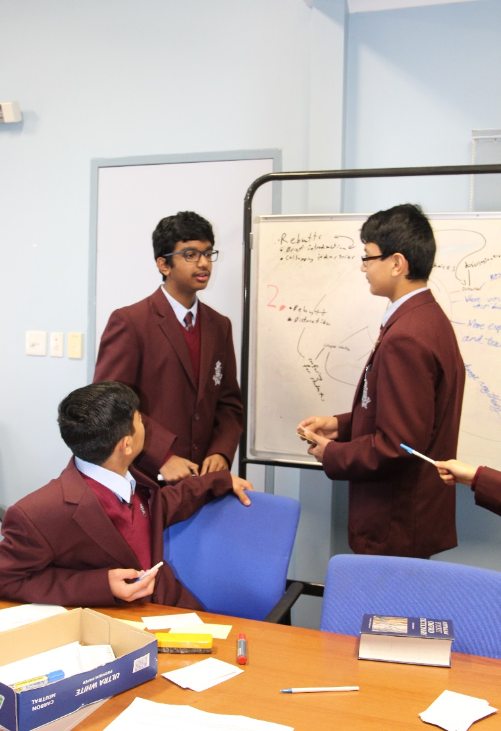
Beyond the Curriculum
Digital Media Team
Cubing Club – Rubix Cube
Coding Club

Slide 15
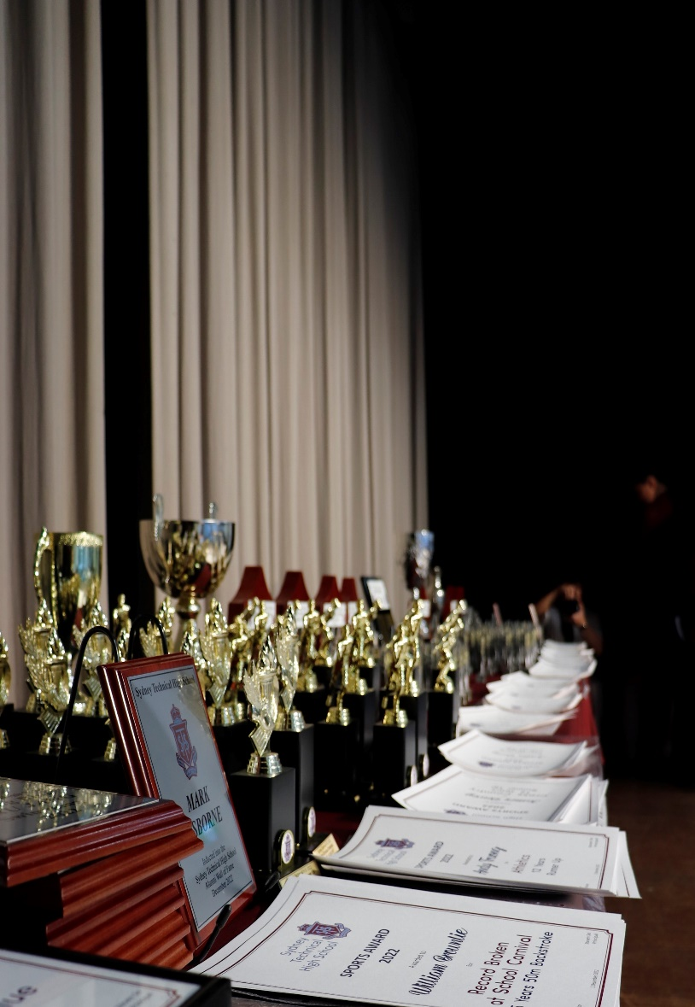
Academic Awards
Awards are given to students at our yearly Presentation Day Assembly for Academic excellence.
Years 7 and 8 - Five Outstanding Academic Achievement awards are given per class.
Years 9 to 11- Awards are given for excellence in each subject
Year 12 – Awards are given based on HSC results

Slide 16
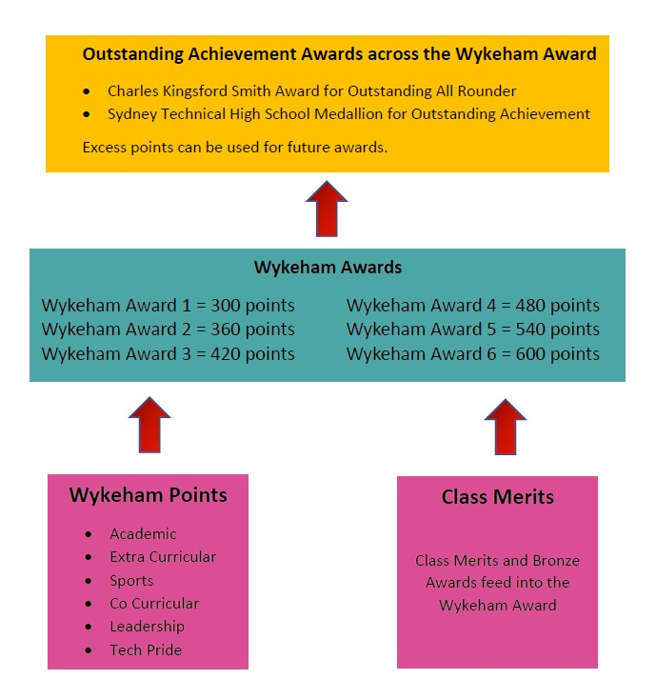
The Wykeham Award System
Sydney Tech’s most prestigious achievement, acknowledging our most well rounded students across all aspects of school life.

Slide 17
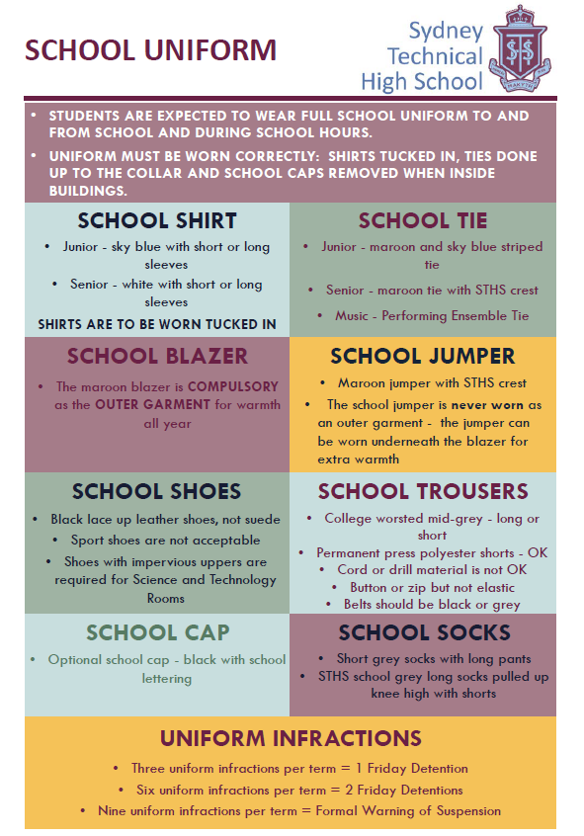
Other Important Matters
School Uniform – For new, visit Lowes Menswear. For second hand, visit our second hand uniform shop located in Vera’s Cottage, on school grounds, every second Thursday.
Canteen – Open daily to our students, eftpos facility is available.
Transport - Visit Transport NSW to work out the best route for your son to arrive to and from school safely.

Slide 18
Where to for answers?

Slide 19
Questions

